Slide 2
Syllabus:
Recombinant DNA technology and DNA identification technologies are applied in agriculture and environmental conservation
Describe how Recombinant DNA technology is used to clone genes using bacteria
Describe how Recombinant DNA technology is used to genetically modify an organisms DNA and create Transgenic organisms
Essential
Question:

Slide 3
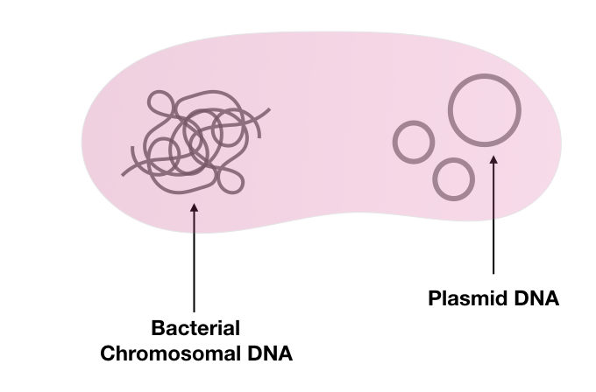
Genetic engineering techniques
Topic Question 1: Explain why plasmids can be used to copy DNA
Plasmids make good DNA copiers because:
plasmids can incorporate foreign DNA
their small, circular nature gives them stability
plasmids can be copied within bacteria, which are easily grown in the lab
plasmids can replicate even when they contain foreign DNA

Slide 4
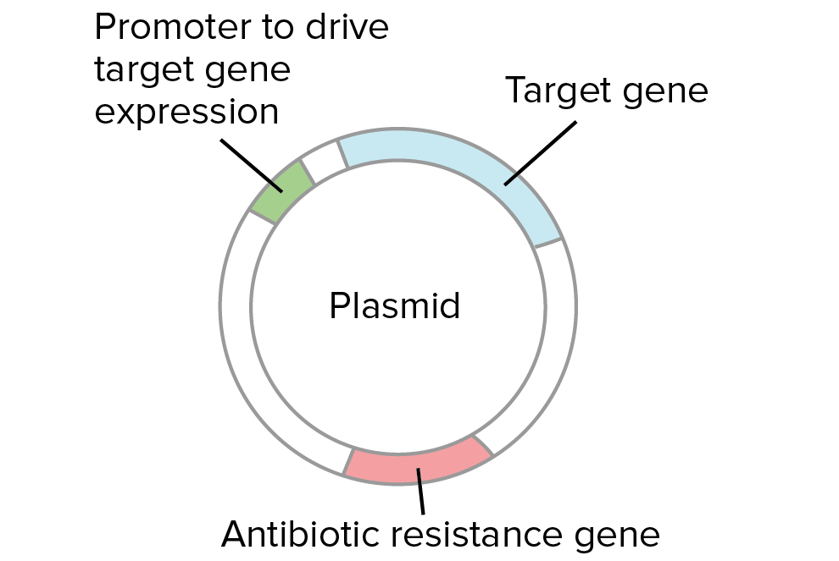
Genetic engineering techniques
Topic Question 1: Explain why plasmids can be used to copy DNA
Genes on plasmids can be expressed in bacteria.
    When these genes confer antibiotic resistance, they are called selection markers.
    Growing bacteria in antibiotic-containing media ensures only the cells containing the plasmids grow. This is the basis of antibiotic selection.

Slide 5
Genetic engineering techniques
Topic Question 2: Define the terms GMO and transgenic organism
Recombinant DNA technology can be used to create genetically modified organisms (GMOs) and transgenic organism. Although thesis terms are commonly used interchangeable they are not the same.
GMO
is an organism that has an artificially altered genome,

Slide 6
Genetic engineering techniques
Topic Question 2: Define the terms GMO and transgenic organism
Transgenic organism
is a GMO that has an altered genome containing a DNA sequence or gene from a different species.
The process used to create a transgenic organism is called transgenesis
Transgenic organisms have been engineered for desirable traits, including resistance, faster growth rate, greater product quality/yield and tolerance to adverse environmental conditions
Have been engineered to reduce the pressure of farming industries and environmental conservation

Slide 7
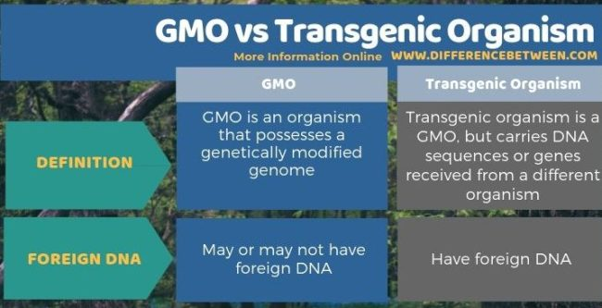
Topic Question 2: Define the terms GMO and transgenic organism
https://www.youtube.com/watch?v=vribRyVQ6G8

Slide 8
Genetic engineering techniques
Topic Question 3: State the role of restriction enzymes, ligase, plasmid and vector play in gene cloning
Part of the gene cloning process | Role
Restriction enzymes | Cuts target gene from donor organisms and cuts plasmid DNA so gene can be inserted
Ligase | Binds target gene to plasmid DNA
Plasmid | Makes large amount of the target gene
Vector | Introduces target gene into recipient organism
Notes:
To transfer genes into another organism, the genes need to be delivered in such a way that they can be active (expressed) in that organism.
Recombinant gene technology can replace missing or impaired genes in diseases where single genes are affected.
To transfer genes into another organism, the genes need to be delivered in such a way that they can be active (expressed) in that organism.
Vectors are tools that can transport DNA from one organism to another.
Plasmids can be used as vectors, and viruses are useful natural vectors which can often accept large foreign DNA inserts.
Viruses already contain the machinery for replicating themselves and injecting DNA into cells.

Slide 9
Genetic engineering techniques
Topic Question 4: Describe how recombinant DNA technology can be used to genetically modify bacteria to produce a protein it does not normally
Copying DNA using plasmids is called genetic cloning. The process involves the following steps.
Extracting plasmids from bacterial cells by rupturing (lysing) them
Cutting the plasmid with restriction enzymes
Cutting the DNA fragment to be inserted with the same restriction enzymes (to give the same sticky ends)

Slide 10
Genetic engineering techniques
Topic Question 4: Describe how recombinant DNA technology can be used to genetically modify bacteria to produce a protein it does not normally
Incubating the cut fragment and plasmid together with DNA ligase
Inserting the plasmid into bacterial cells. This is called transformation.
Selecting transformed bacteria by growing them in antibiotic-containing media.

Slide 11
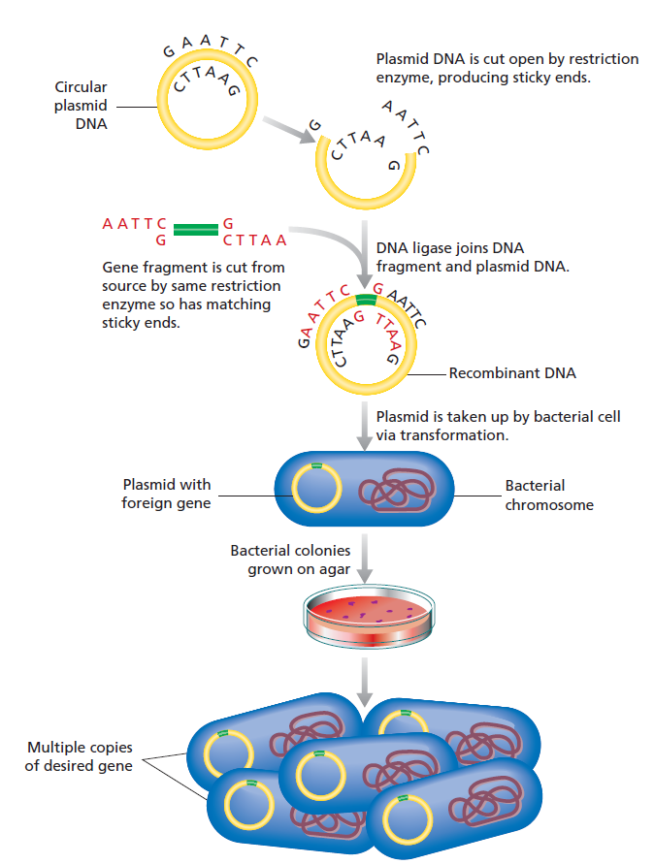
If the gene is expressed the Bacteria has produced the protein coded by the gene
https://www.youtube.com/watch?v=DIM38NlkWEo
Figure 5.14

Slide 12
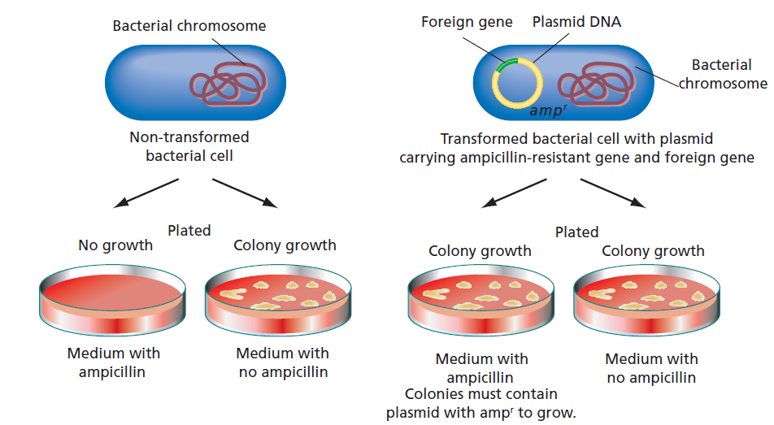
Topic Question 5: Describe how scientists identify which bacterial cells contain recombined DNA
Genetic engineering techniques
Figure 5.15

Slide 13
Topic Question 6: Agrobacterium tumefaciens is a species of soil-borne bacteria that can infect plant cells and cause crown gall disease. A tumefaciens is widely used in recombinant DNA technology as a vector for gene transfer.
Outline why Agrobacterium is well-suited to this role of vector in creating transgenic plants
Agrobacterium is used as a vector to transfer foreign genes into the plants
It naturally transfers DNA/genes into plant cells (during disease production)
It can infect a wide range of host plants

Slide 14
Topic Question 7: Agrobacterium tumefaciens is a species of soil-borne bacteria that can infect plant cells and cause crown gall disease. A tumefaciens is widely used in recombinant DNA technology as a vector for gene transfer.
Outline how Agrobacterium is used in the production of transgenic plants
Agrobacterium tumefaciens acts like a vector by transferring genes found on its plasmids to the cells of other organisms
The transferred genes are incorporated into the hosts genome

Slide 15
Topic Question 8: Agrobacterium tumefaciens is a species of soil-borne bacteria that can infect plant cells and cause crown gall disease. A tumefaciens is widely used in recombinant DNA technology as a vector for gene transfer.
Construct a labelled flow diagram outlining the stages involved in the development of a transgenic plant using Agrobacterium tumefaciens.

Slide 17
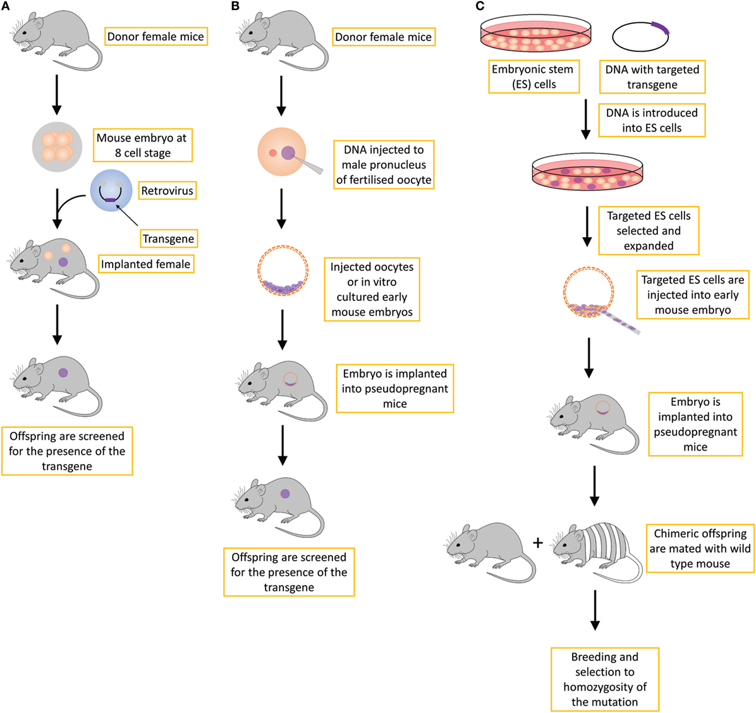
viruses are useful natural vectors which can often accept large foreign DNA inserts.
Viruses already contain the machinery for replicating themselves and injecting DNA into cells.

Slide 18
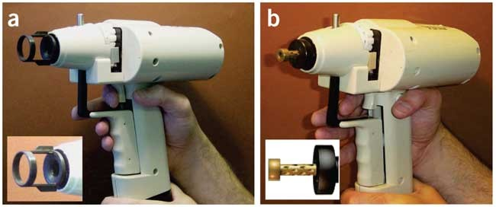
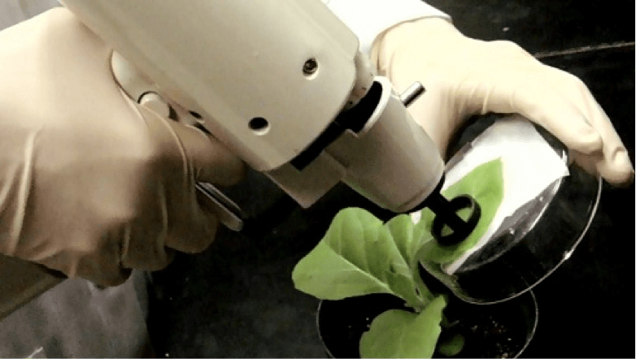
Gene Gun
Gene gun bombardment is a method for the physical introduction of DNA into plant cells containing cell walls
https://www.sciencedirect.com/topics/biochemistry-genetics-and-molecular-biology/gene-gun#:~:text=Gene%20gun%20bombardment%20is%20a,compressed%20helium%20as%20the%20propellant.
Notes:
The gene gun is utilized to bombard the plant cell wall with many DNA coated metal particles by using compressed helium as the propellant. The metal particles commonly used for gene gun bombardment include gold, tungsten, palladium, rhodium, platinum, and iridium. They are coated with DNA, accelerated by helium gas, and bombard the plant cells. The metal particles (0.45–1.5 μm in diameter) punch holes in and pass through the cell wall and enter the plant cells, leaving the DNA cargo inside the cells. The DNA coated metal particles randomly bombard the cells, no targeting is currently possible with this method.

